Slide 1
Classification of Depression on Social Media using Text Mining
Submitted in the partial fulfillment for the award of the degree of
BACHELOR OF ENGINEERING
IN
Artificial Intelligence and Machine Learning
Submitted by:
Pranay Reddy(18BCS6100)
Karishma Kansal(18BCS6103)
Chitrang Juneja(18BCS6115)
Sejal Gulati(18BCS6116)
Sachin Kaushik(18BCS6119)
Under the Supervision of:
Gurpreet Singh Panesar
Department of AIT-CSE
DISCOVER . LEARN . EMPOWER

Slide 2
Outline
Introduction to Project
Problem Formulation
Objectives of the work
Methodology used
Results and Outputs
Conclusion
Future Scope
References

Slide 3
Introduction to Project
Mental illness has been prevalent in the world, depression is one of the most common psychological problem we know.
With the use of the Large amount of data tweets and Facebook post online we can use machine learning to data mine it and be able to produce a meaningful and useful outcome.
Social media generates countless data every day because of millions of active users share and communicate in entire community, it changes human interaction. For this project, we will be using Python and various modules and libraries.
The aim of the project is to predict early signs of depression through Social Media text mining.

Slide 4
Introduction to Project
Other than the traditional data, such as literatures, social media data is richer and more accessible. However, investigating this new fast-growth of data requires advanced development tool to discover useful insights. These advanced technologies include Natural Language Processing (NLP) ,data mining, machine learning, social media analysis and so on.
In our research, the goal is to extract and summarize the uncommon but potentially helpful factors that depressive symptom performed from the social media data.

Slide 5
Problem Formulation
The significant challenge of detecting depression is the recognition that Depressive symptoms may differ from patients’ behaviour and personality.
For clinic depression, doctors may evaluate the patient via the depression test taken by patients. Apparently, these clinical records are restricted due to many factors, such as age, sex; moreover, they are private and expensive.
To overcome such limitations of clinical data, it would be beneficial to use text mining tools to extract and analyse depression symptoms from social media, such as Twitter.

Slide 6
Objectives
We planned to study different model combinations so that we can make use of ML and feature sets.
Learned more about neural networks and natural language processing.
Learned how to make use of various machine learning libraries.
Learned how to use data mining in order to extract the social media posts.

Slide 7
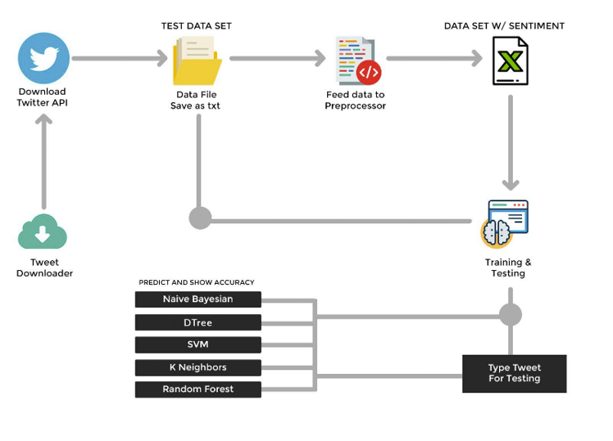
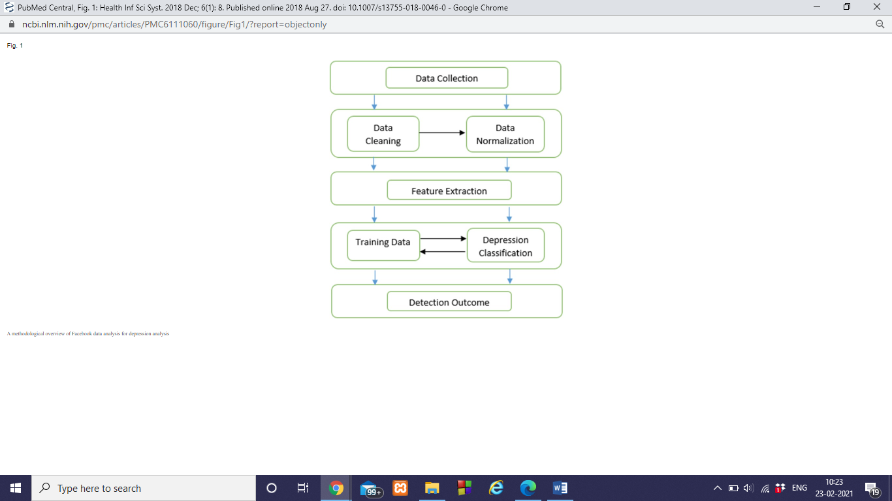
Methodology used

Slide 8
Methodology used
In this study, we ﬁrst focused on four types of factors such as emotional process, temporal process, linguistic style and all (emotional, temporal, linguistic style) features together for the detection and processing of depressive data received as Facebook posts.
We then apply supervised machine learning approaches to study each factor types independently. Various classiﬁcation techniques such as ‘decision tree’, ‘k-Nearest Neighbour’, ‘Support Vector Machine’, and ‘ensemble’ are used for this project.

Slide 9
Results and Outputs
Took some random comments from twitter for testing.
Output will be positive, negative or neutral according to the comment.
If the classifier find mood of the person as positive according to the comment, output will be positive.
If the classifier find the person is depressive according to the comment, output will be negative.
For neutral comments, output will be neutral.
Following slides consists of some screenshots of the inputs and the respective outputs.

Slide 10
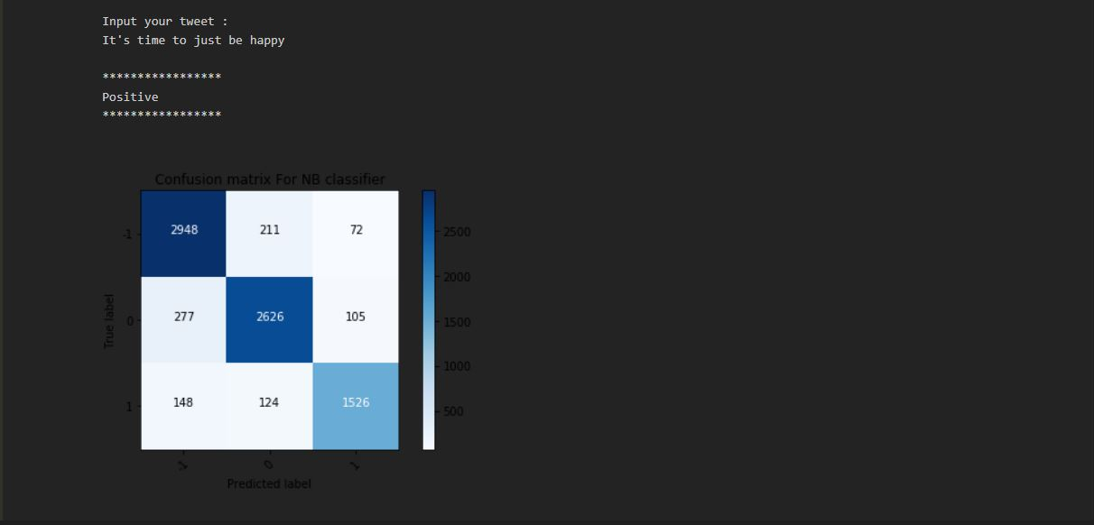
Results and Outputs

Slide 11
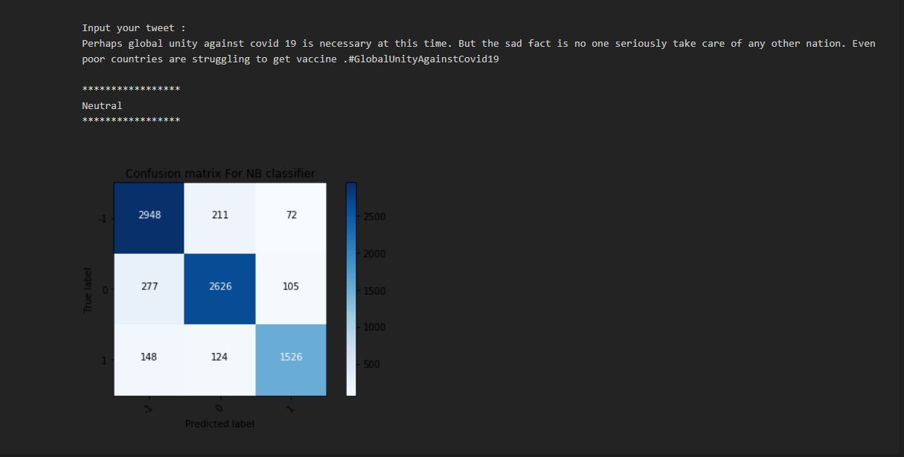
Results and Outputs

Slide 12

Results and Outputs

Slide 13
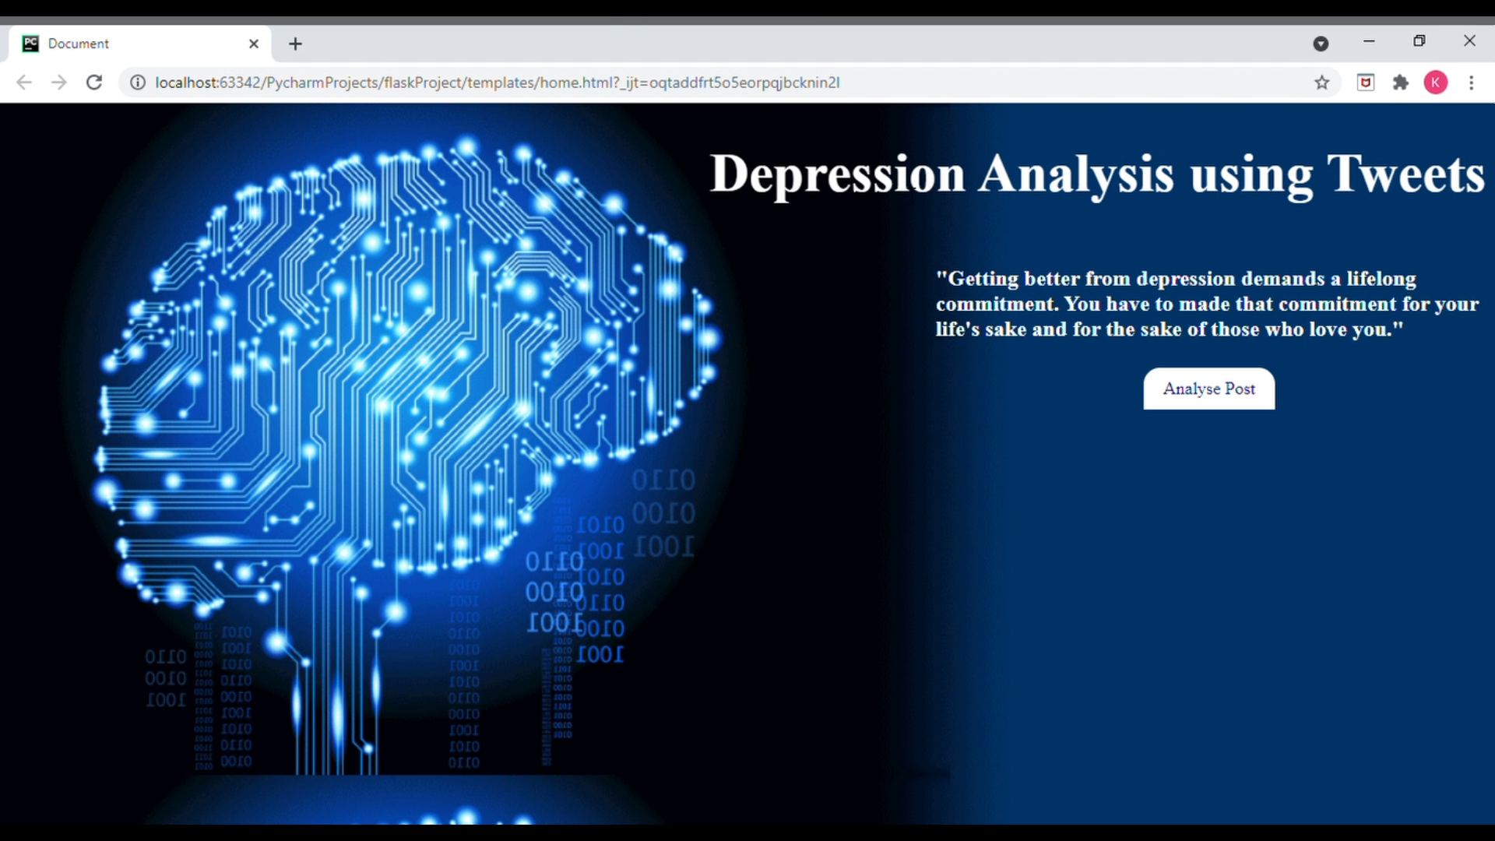
Results and Outputs

Slide 14
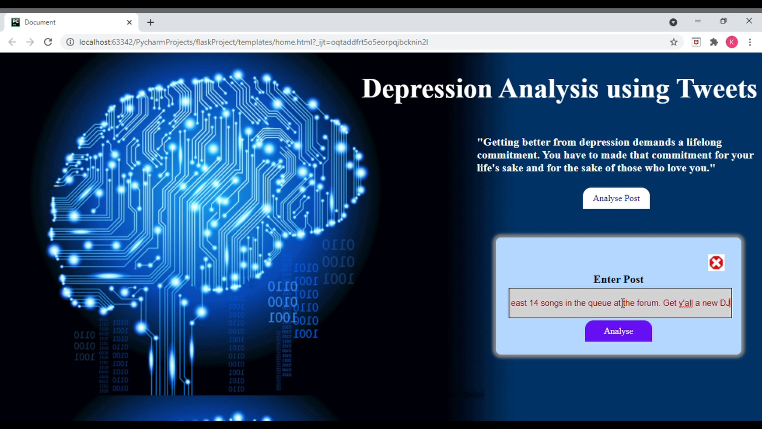
Results and Outputs

Slide 15
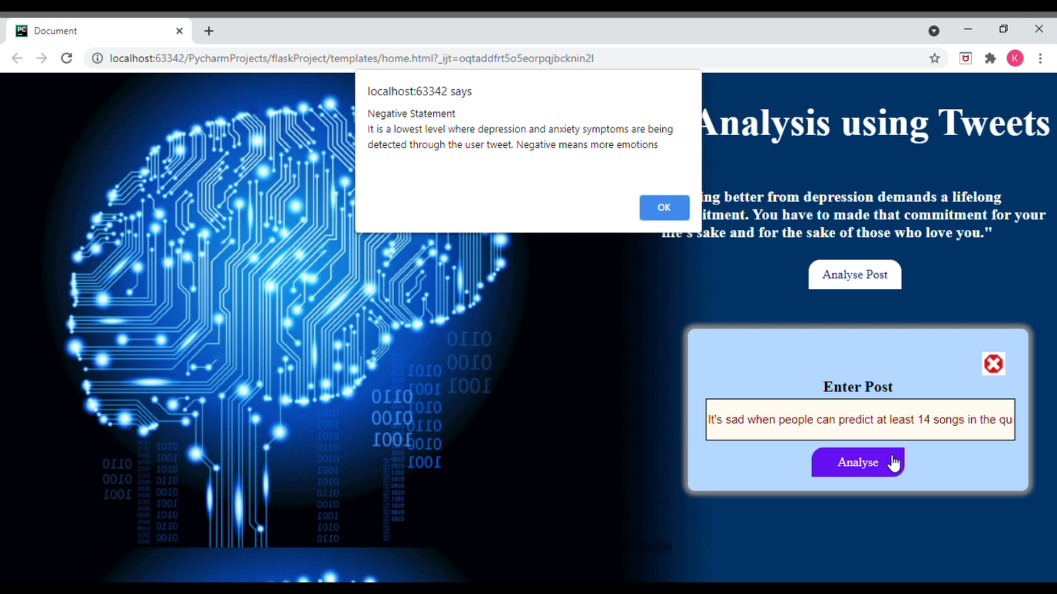
Results and Outputs

Slide 16
Conclusion
Clinic depression has been a serious mental illness since past decades which negatively affects human’s health. It is difficult to confirm human’s depression symptoms from their behaviors via restricted clinic records.
Our proposed methods and experiments illustrate that social network and web blogs provide rich information for depression symptoms extraction from a distinctive perspective. Current advanced natural language processing approach, like Word2Vec, can be helpful for medical uses.
In the future, we will collect other types of data, e.g. image and video from other social networks. Additionally, advanced entity selection technique would be used to select more accurate and meaningful depression symptoms. We were successfully able to detect the right results in our project i.e.- Classifying if the person who posted that post, has the symptoms of depression or not.

Slide 17
Future Scope
Use Contextual Semantic segmentation.
Use Stop words to increase accuracy of model.
Eliminating features with extremely low frequency.
Use Complex Features: n-grams and part of speech tags.

Slide 18
References
1.https://www.researchgate.net/publication/318136574_Extracting_Depression_Symptoms_from_Social_Networks_and_Web_Blogs_via_Text_Mining
2. https://vgpena.github.io/classifying-tweets-with-keras-and-tensorflow/
3. https://github.com/AshwanthRamji/Depression-Sentiment-Analysis-with-Twitter-Data
4. Griffin, J. M., Fuhrer, R., Stansfeld, S. A., Marmot, M.: The importance of low control at work and home on depression and anxiety: do these effects vary by gender and social class?. Social science and medicine, vol. 54(5), pp. 783--798. (2002)
5. Cai, Z., He, Z., Guan, X. Li, Y.: Collective data-sanitization for preventing sensitive information inference attacks in social networks. IEEE Transactions on Dependable and Secure Computing. (2016)
6. A Hybrid Document Feature Extraction Method Using Latent Dirichlet Allocation and Word2Vec | Request PDF (researchgate.net)

Slide 19
References
7. https://ieeexplore.ieee.org/document/9277251
8. https://github.com/laugustyniak/awesome-sentiment-analysis
9. https://github.com/arnab39/Sentiment-Analysis-of-Citations
10. A Hybrid Document Feature Extraction Method Using Latent Dirichlet Allocation and Word2Vec | Request PDF (researchgate.net)
11. DEEP LEARNING METHODS FOR DISEASE DETECTION AND CLASSIFICATION | Jyoti Islam | Research Project (researchgate.net)

